Slide 1

Lecture 4: Programming
AP Computer Science Principles

Slide 2
Programming

Slide 3
A Program
program: A set of instructions
to be carried out by a computer.
program execution: The act of
carrying out the instructions
contained in a program.
programming language: A systematic set of rules used to describe computations in a format that is editable by humans.

Slide 4
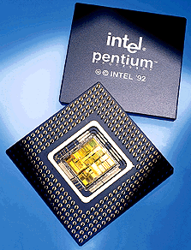
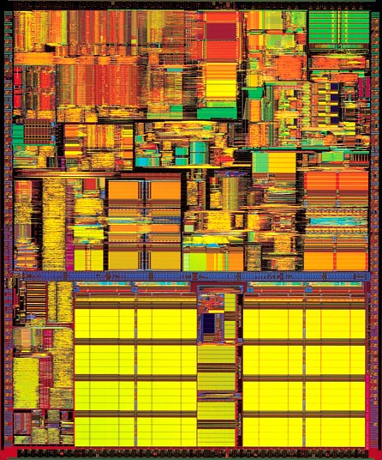
CPU
Computers are fast
  Pentium G4560(dual-cores) can perform approximately 3,500,000,000(3.5 Ghz) computations per second
  made up of 3,300,000,000 transistors (a switch that is on or off)
Computers are dumb
  They can only carry out a very limited set of instructions
    on the order of 100 or so depending on the computer's processor
    machine language instructions, aka instruction set architecture (ISA)
    Add, Branch, Jump, Get Data, Get Instruction, Store.

Slide 5

Neumann
John von Neumann - co-author of paper in 1946 with Arthur W. Burks and Hermann H. Goldstine,
  "Preliminary Discussion of the Logical Design of an Electronic Computing Instrument"
One of the key points
  program commands and data stored as sequences of bits in the computer's memory
A program:
1110001100000000
0101011011100000
0110100001000000
0000100000001000
0001011011000100
0001001001100001
0110100001000000

Slide 6
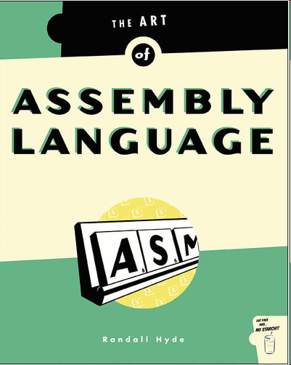
Low-level programming
Programming at a low-level(closer to the hardware level) with Strings of bits (1s or 0s) is not the easiest thing in the world.
Assembly language(a little bit higher level, but not much)
  mnemonics for machine language instructions
  .ORIG x3001
  LD R1, x3100
  AND R3, R3 #0
  LD R4, R1
  BRn x3008
  ADD R3, R3, R4
  ADD R1, R1, #1
  LD R4, R1
  BRnzp x3003

Slide 7
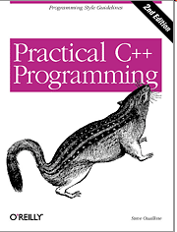
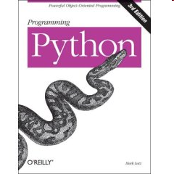
Higher Level Programming
Assembly language has lots of commands to accomplish simple things.
High Level Computer Languages provide the ability to accomplish a lot with fewer commands than machine or assembly language in a way that is hopefully easier to understand and write.
  int sum = 0;
  int count = 1;
  while(count <= 10){
  sum = sum + count;
  count = count + 1;
  }

Slide 8
Languages
There are hundreds of high level computer languages. Java, C++, C, Basic, Fortran, Cobol, Lisp, Perl, Python, Javascript.
The capabilities of the languages vary widely, but they all need a way to do
  declarative statements
  conditional statements
  iterative or repetitive statements
A compiler is a program that converts commands in high level languages to machine language instructions.

Slide 9
Some modern languages
procedural languages: programs are a series of commands
  Pascal (1970): designed for education
  C (1972): low-level operating systems and device drivers
functional programming: functions map inputs to outputs
  Lisp (1958) / Scheme (1975), ML (1973), Haskell (1990)
object-oriented languages: programs use interacting "objects”
  C++ (1985): "object-oriented" improvements to C
    successful in industry; used to build major OSes such as Windows
  Java (1995): designed for embedded systems, web apps/servers.
    Runs on many platforms (Windows, Mac, Linux, cell phones...)

Slide 10

A Picture is Worth…
The output of the compiler is .class file
The Interpreter's are sometimes referred to as the Java Virtual Machines

Slide 11
Java
Java will be the primary language we’ll use. (We’ll be introduced to HTML/CSS/Javascript/Python later).
The editor(or IDE, Integrated Development Environment) is Processing.

Slide 12
Processing
Processing started by Ben Fry and Casey Reas while both were graduate students at MIT Media Lab in 2001.
Processing is Java.
Designed for visual artists with limited programming experience who want to create art, animation and games without knowing complicated Java syntax.
In its current version, hundred of libraries have been written for computer vision, data visualization, music composition, networking, 3D drawings and programming electronics.

Slide 13
Processing
A program, called a sketch, in Processing, at its most basic, consists of just two methods(a method is a sequence of code that perform a specific task): setup() and draw().
setup(): initializing variables, setting up window size, etc…
draw(): repeats 60 times a second(60hz refresh rate), responsible for the animation and flow of a program.

Slide 14
Our First Program

Slide 15
Java
Java is case sensitive.
Every statement of code ends with a semicolon.
// marks the beginning of an inline comment. The compiler will ignore everything after the //.
// This is a comment.
// So is this.
int x = 3; //this is an inline comment.
Extra whitespace/tabs/returns are ignore.

Slide 16
A basic sketch
// global variables are declared at the top before setup()
void setup(){
// code here to initialize global variables,
// background color, window size, etc…
// setup() is run only once.
}
// draw is a loop that runs
// automatically 60 frames per second
// used for animation
void draw(){
// code for updating variables for next frame
// creating illusion of animation
}

Slide 17
Example
int x; //declaring global variables; not initialized
void setup(){
//initializing x and y
x = 5;
}
void draw()
{
x = x + 1; //x increases by 1
// 60 times per second.
}

Slide 18
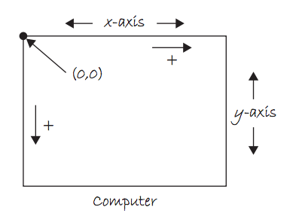
Coordinate System

Slide 19
Example 1
int centerX, centerY;
void setup(){
size(800,600); // window width=800 pixels, height=600 pixels
centerX = 400;
centerY = 300; //(centerX,centerY)center of window
}
void draw(){
background(255); //white background
fill(255,0,0); //red fill (Red,Green,Blue) color (RGB)
ellipse(centerX,centerY,80,80);
//red circle radius 40(diameter=80)
}

Slide 20
Making it move!
int centerX, centerY, xspeed;
void setup(){
size(800,600); // window width=800 pixels, height=600 pixels
centerX = 400;
centerY = 300; //(centerX,centerY) center of window
xspeed = 5;
}
void draw(){
background(255); //white background
fill(255,0,0); //red fill (Red,Green,Blue) color (RGB)
ellipse(centerX,centerY,80,80); //red circle radius 40
centerX = centerX + xspeed; //updating centerX
//every frame, centerX increases by 5,
// ball moves horizontal 5 pixels to the right.
}

Slide 21
Back and Forth
int centerX, centerY, xspeed;
void setup(){
size(800,600); // window width=800 pixels, height=600 pixels
centerX = 400;
centerY = 300; //(centerX,centerY) center of window
xspeed = 5;
}
void draw(){
background(255); //white background
fill(255,0,0); //red fill (Red,Green,Blue) color (RGB)
ellipse(centerX,centerY,80,80); //red circle radius 40
centerX = centerX + xspeed; //updating centerX
if (centerX > 800 || centerX < 0) { // || means “or”
xspeed = -xspeed;
}
}

Slide 22
Processing References
The Processing website is a great reference for learning about Processing. There are tutorials on different topics, videos, etc…
A quick way to learn how to do something on Processing is through Google. If I want to know how to draw a rectangle. Search for “draw rectangle processing”, the first result will take you directly to the code on Processing.
There are also many videos on Processing on youtube.

Slide 23
Lab 1
Download Processing at https://www.processing.org/.
Retype the previous program to see the ball bouncing back and forth. Please, for this first time, DO NOT copy and paste. Practice learning how to do this without any reference.
Modify the program so that the ball moves in a diagonal direction by adding a vertical speed, yspeed.
Add an “if” conditional to make sure the ball bounces of the top and bottom of the screen.

Slide 24
Lab 1(continued)
Some more things to try.
Play around with the window size.
Try changing the background into RGB color instead of greyscale.
As the program is written here, the ball does not perfectly bounces off the edge of the window. Fix it!

Slide 25
Homework
Read and reread these lecture notes.
Download processing. https://www.processing.org/
Do the lab. Learn and understand the code.

Slide 26
References
Part of this lecture is taken from the following book.
1) Stuart Reges and Marty Stepp. Building Java Programs: A Back to Basics Approach. Pearson Education. 2008.

